Slide 1
演算法 EXTRA POINTS
陳廷威 4103056042
廖偉傑 4103056043
黃泓叡 4102056049

Slide 2
RING DETECTION PROBLEM

Slide 3
GOAL
We need to identify all rings whose length is k in the Directed Graph. k and Directed Graph are given.

Slide 4
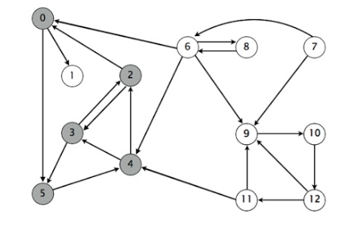
Here is the graph

Slide 5
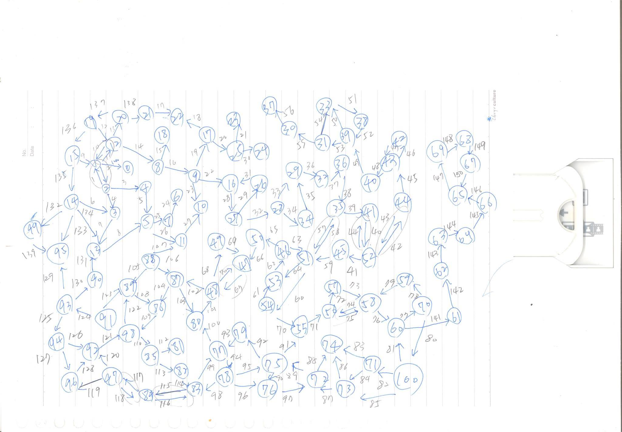
INPUT

Slide 6
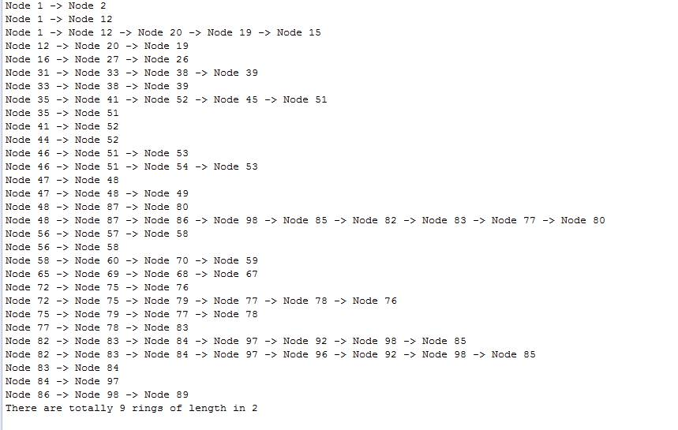
RUNNING RESULT

